Slide 1
8
Disk Storage, Basic File Structures, and Hashing

Slide 2
8.3 Basic File Structures

Slide 3
Placing File Records on Disk
Record: collection of related data values or items
Values correspond to record field
Data types
Numeric
String
Boolean
Date/time
Binary large objects (BLOBs)
Unstructured objects

Slide 4
Fixed vs Variable Length Records

Slide 5
Placing File Records on Disk (cont’d.)
Reasons for variable-length records
One or more fields have variable length
One or more fields are repeating
One or more fields are optional
File contains records of different types

Slide 6
File Organization
The database is stored as a collection of files. Each file is a sequence of records. A record is a sequence of fields.
One approach
Assume record size is fixed
Each file has records of one particular type only
Different files are used for different relations
This case is easiest to implement; will consider variable length records later
We assume that records are smaller than a disk block

Slide 7
Fixed-Length Records
type instructor = record
ID varchar (5);
name varchar(20);
dept name varchar (20);
salary numeric (8,2);
End
Assume:
Each character occupies 1 byte
Numeric (8,2) occupies 8 bytes.
If we allocate the maximum number of bytes that each attribute can hold, then, the instructor record is 53 bytes long.
Notes:
Suppose that instead of allocating a variable amount of bytes for the attributes ID, name, and dept name

Slide 8
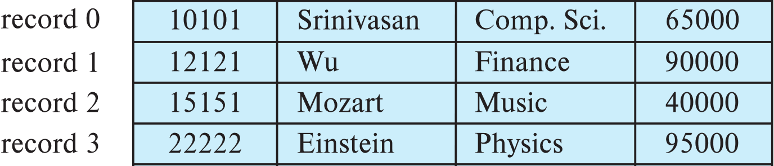
Fixed-Length Records
A simple approach is to use the first 53 bytes for the first record, the next 53 bytes for the second record, and so on
Drawback
Unless the block size happens to be a multiple of 53, some records will cross block boundaries.
It would thus require two block accesses to read or write such a record.
It is difficult to delete a record from this structure.
The space occupied by the record to be deleted must be filled with some other record of the file, or we must have a way of marking deleted records so that they can be ignored.
Notes:
Unless the block size happens to be a multiple of 53 (which is unlikely), some records will cross block boundaries. That is, part of the record will be stored in one block and part in another. It would thus require two block accesses to read or write such a record.
It is difficult to delete a record from this structure. The space occupied by the record to be deleted must be filled with some other record of the file, or we must have a way of marking deleted records so that they can be ignored.

Slide 9
Record Blocking and Spanned Versus Unspanned Records
File records allocated to disk blocks
Spanned records
Larger than a single block
Pointer at end of first block points to block containing remainder of record
Unspanned
Records not allowed to cross block boundaries

Slide 10
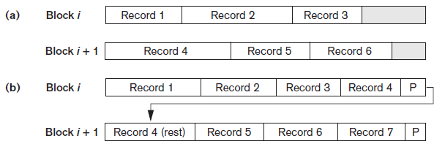
Record Blocking and Spanned Versus Unspanned Records (cont’d.)
Blocking factor
Average number of records per block for the file
Types of record organization (a) Unspanned (b) Spanned

Slide 11
Fixed-Length Records
Avoid Spanning of Records
To avoid the first problem, we allocate only as many records to a block as would fit entirely in the block
this number can be computed easily by dividing the block size by the record size, and discarding the fractional part.
Any remaining bytes of each block are left unused.
Store record i starting from byte n ∗ (i – 1), where n is the size of each record.
Notes:
Unless the block size happens to be a multiple of 53 (which is unlikely), some records will cross block boundaries. That is, part of the record will be stored in one block and part in another. It would thus require two block accesses to read or write such a record.

Slide 12
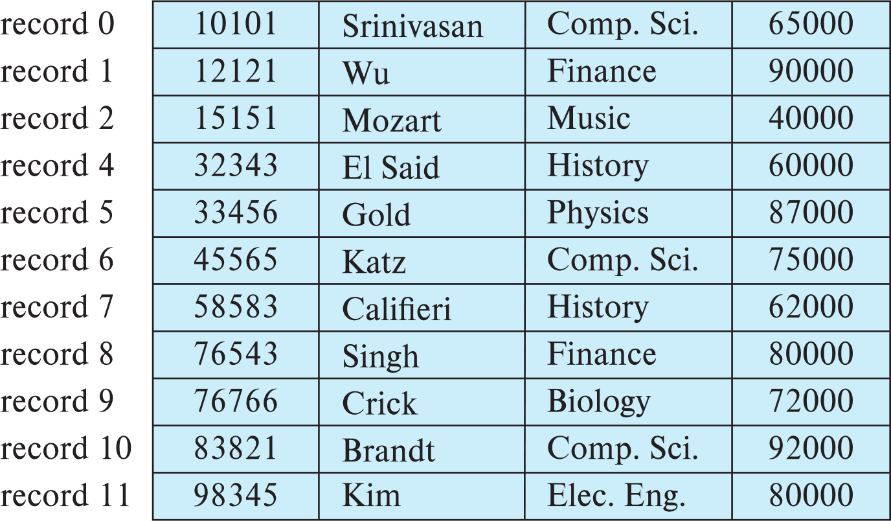
Fixed-Length Records
Deletion of record i: alternatives:
move records i + 1, . . ., n to i, . . . , n – 1
move record n to i
do not move records, but link all free records on a free list
Record 3 deleted

Slide 13
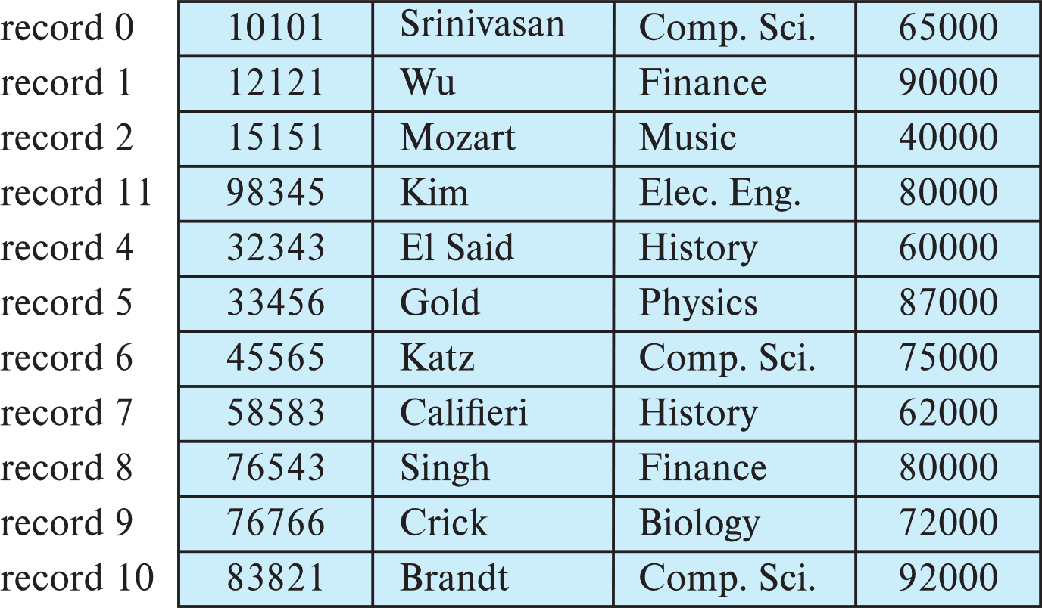
Fixed-Length Records
Deletion of record i: alternatives:
move records i + 1, . . ., n to i, . . . , n – 1
move record n to i
do not move records, but link all free records on a free list
Record 3 deleted and replaced by record 11

Slide 14
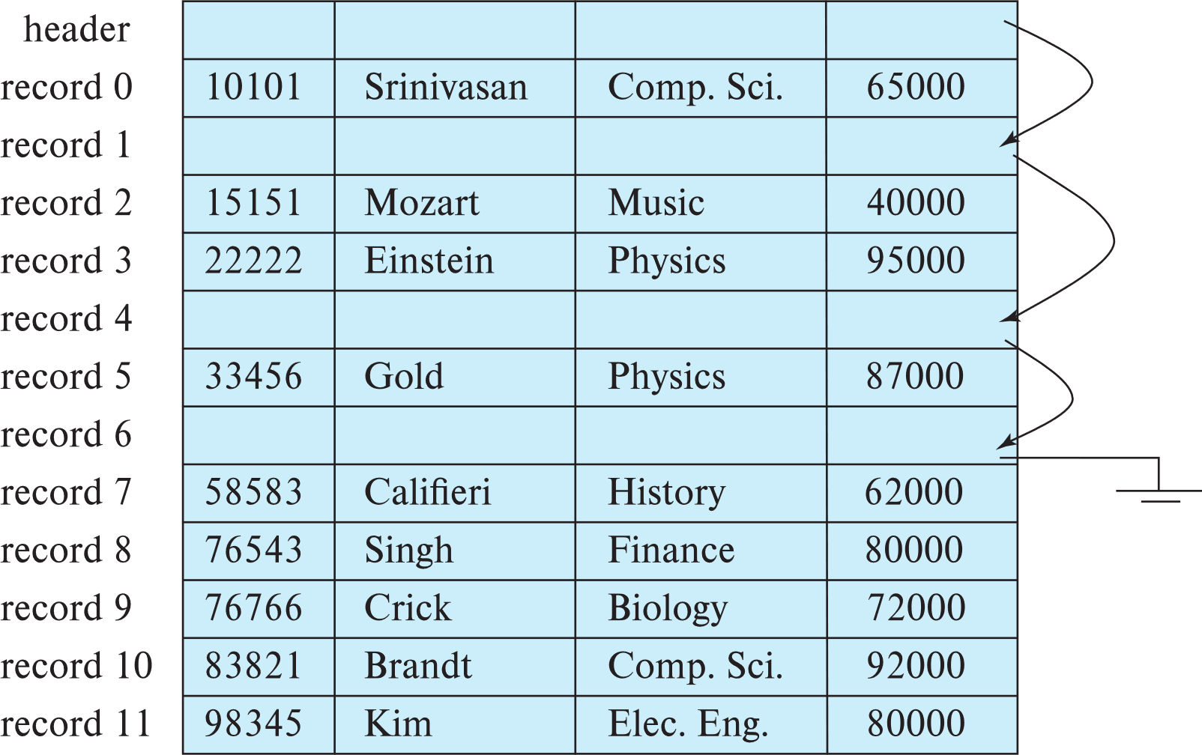
Fixed-Length Records
Deletion of record i: alternatives:
move records i + 1, . . ., n to i, . . . , n – 1
move record n to i
do not move records, but link all free records on a free list

Slide 15
Variable Length Records

Slide 16
Variable-Length Records
Variable-length records arise in database systems in several ways:
Storage of multiple record types in a file.
Record types that allow variable lengths for one or more fields such as strings (varchar)
Record types that allow repeating fields (used in some older data models).
Two different problems must be solved by any such technique:
How to represent a single record in such a way that individual attributes can be extracted easily, even if they are of variable length
How to store variable-length records within a block, such that records in a block can be extracted easily

Slide 17
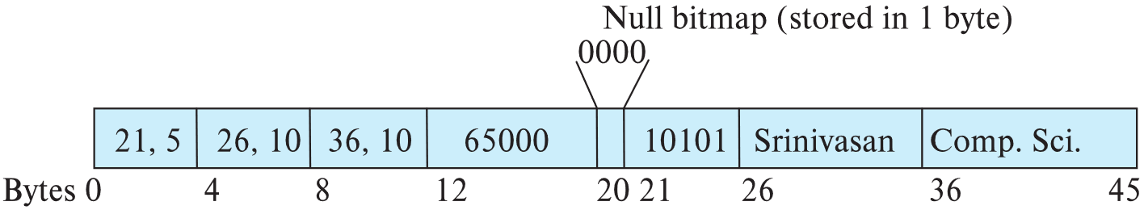
Variable-Length Records
Attributes are stored in order
Variable length attributes represented by fixed size (offset, length), with actual data stored after all fixed length attributes
Null values represented by null-value bitmap
ID varchar (5)
name varchar(20)
dept name varchar (20)
salary numeric (8,2)
Variable-length attributes
Fixed-length attribute

Slide 18
Null bitmap
Instructor(ID, name, dept_name, salary)
If the name were null, then Null bitmap =
If the dept_name were null, then Null bitmap =
If the salary were null, then Null bitmap =
0100
0010
0001
In some representations, the null bitmap is stored at the beginning of the record, and for attributes that are null, no data (value, or offset/length) are stored at all.
Notes:
saves some storage space, at the cost of extra work to extract attributes of the record.
useful for certain applications where records have a large number of fields, most of which are null.

Slide 19
Null bitmap
If the salary were null, the fourth bit of the bitmap would be set to 1, and bytes 12 through 19 would be ignored.
Since the record has four attributes, the null bitmap for this record fits in 1 byte, although more bytes may be required with more attributes.
In some representations, the null bitmap is stored at the beginning of the record, and for attributes that are null, no data (value, or offset/length) are stored at all.
Such a representation would save some storage space, at the cost of extra work to extract attributes of the record.
This representation is particularly useful for certain applications where records have a large number of fields, most of which are null.

Slide 20
Storing Large Objects
E.g., blob type
Records must be smaller than pages
Alternatives:
Store as files in file systems
Store as files managed by database
Break into pieces and store in multiple tuples in separate relation

Slide 21
Allocating file blocks on disk
Allocating file blocks on disk
Contiguous allocation
Linked allocation
Indexed allocation
File header (file descriptor)
Contains file information needed by system programs
Disk addresses
Format descriptions
Notes:
contiguous allocation, the file blocks are allocated to consecutive disk blocks. This makes reading the whole file very fast using double buffering, but it makes expanding the file difficult.
In linked allocation, each file block contains a pointer to the next file block. This makes it easy to expand the file but makes it slow to read the whole file.
A combination of the two allocates clusters of consecutive disk blocks, and the clusters are linked. Clusters are sometimes called file segments or extents.
Another possibility is to use indexed allocation, where one or more index blocks contain pointers to the actual file blocks.

Slide 22
Record Formats: Variable Length
Two alternative formats (# fields is fixed):
F1 F2 F3 F4
$
$
$
$
Fields Delimited by Special Symbols
F1 F2 F3 F4
Array of Field Offsets
Second offers direct access to i’th field, efficient storage
of nulls (special don’t know value); small directory overhead.

Slide 23
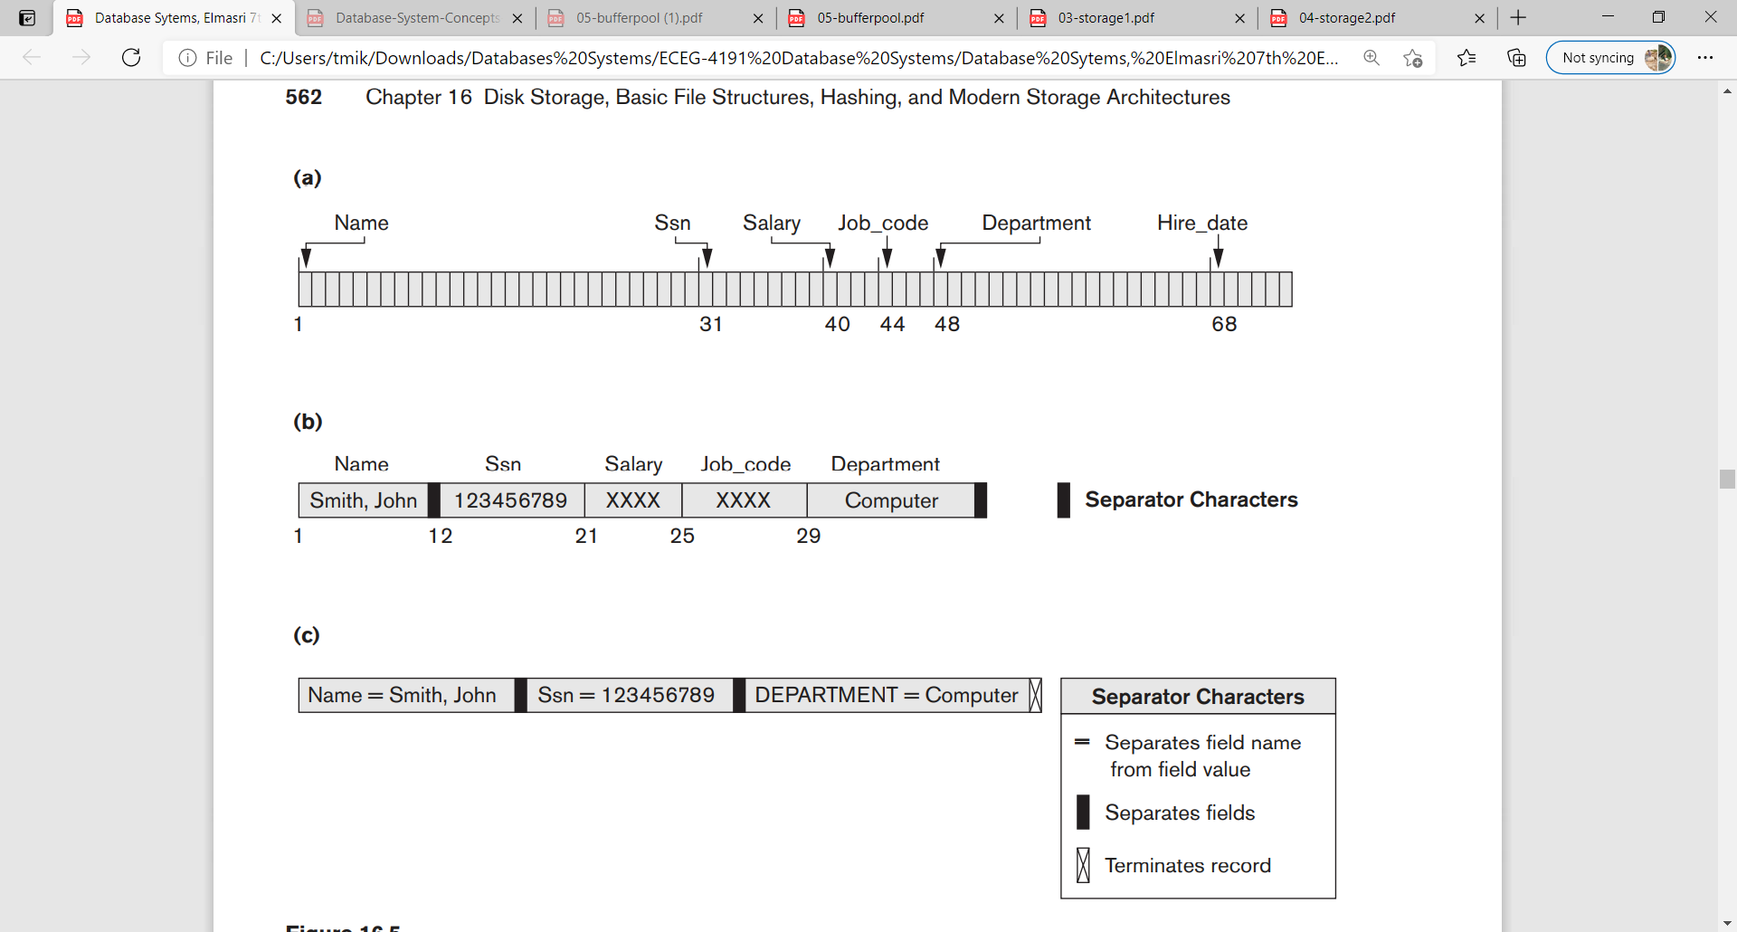
Fixed-Length Records and Variable-Length Records
(a) A fixed-length record with six fields and size of 71 bytes.
(b) A record with two variable-length fields and three fixed-length fields.
(c) A variable-field record with three types of separator characters.

Slide 24
Record Formats: Variable Length
The slotted-page structure is commonly used for organizing records within a block.
There is a header at the beginning of each block, containing the following information:
The number of record entries
The end of free space in the block
An array whose entries contain the location and size of each record

Slide 25
Variable-Length Records: Slotted Page Structure
Records can be moved around within a page to keep them contiguous with no empty space between them
entry in the header must be updated.
Pointers should not point directly to record
they should point to the entry for the record in header.
Notes:
indirection allows records to be moved to prevent fragmentation of space inside a block, while supporting indirect pointers to the record.

Slide 26
Operations on Files
Retrieval operations
No change to file data
Update operations
File change by insertion, deletion, or modification
Records selected based on selection condition

Slide 27
Example of Operations on Files
Search operations on files are generally based on simple selection conditions.
A complex condition must be decomposed by the DBMS to extract a simple condition that can be used to locate the records on disk.
Each located record is then checked to determine whether it satisfies the full selection condition.
Example: ((Salary ≥ 30000) AND (Department = ‘Research’));
Extract (Department = ‘Research’) from the complex condition
each record satisfying (Department = ‘Research’) is located and then tested to see if it also satisfies (Salary ≥ 30000)

Slide 28
Operations on Files (cont’d.)
Examples of operations for accessing file records
Open
Find
FindAll
FindOrdered
Read
FindNext
Delete
Insert
Close
Scan
Reset
Reorganize

Slide 29
Organization of Records in Files
So far, we have studied how records are represented in a file structure.
A relation is a set of records.
Given a set of records, the next question is how to organize them in a file.
Several possible ways to organize records in files

Slide 30
Organization of Records in Files

Slide 31
Organization of Records in Files
Sequential file organization.
Records are stored in sequential order, according to the value of a “search key” of each record
Heap file organization.
Any record can be placed anywhere in the file where there is space for the record.
Multi-Table clustering file organization:
records of several different relations are stored in the same file, and in fact in the same block within a file, to reduce the cost of certain join operations.
B+ Tree file organization.
can provide efficient ordered access to records even if there are a large number of insert, delete, or update operations.
Hashing file organization.
The result of the hash function specifies in which block of the file the record should be placed.

Slide 32
Organization of Records in Files
Heap file organization. Any record can be placed anywhere in the file where there is space for the record. There is no ordering of records. Typically, there is either a single file or a set of files for each relation.
Sequential file organization. Records are stored in sequential order, according to the value of a “search key” of each record.
Multitable clustering file organization: Generally, a separate file or set of files is used to store the records of each relation. However, in a multitable clustering file organization, records of several different relations are stored in the same file, and in fact in the same block within a file, to reduce the cost of certain join operations.
B+-tree file organization. The traditional sequential file organization does support ordered access even if there are insert, delete, and update operations, which may change the ordering of records. However, in the face of a large number of such operations, efficiency of ordered access suffers. The B+-tree file organization is related to the B+-tree index structure and can provide efficient ordered access to records even if there are a large number of insert, delete, or update operations. Further, it supports very efficient access to specific records, based on the search key.
Hashing file organization. A hash function is computed on some attribute of each record. The result of the hash function specifies in which block of the file the record should be placed.

Slide 33
Files of Ordered Records (Sorted Files)
Ordered (sequential) file
Records sorted by ordering field
Called ordering key if ordering field is a key field
Advantages
Reading records in order of ordering key value is extremely efficient
Finding next record
Binary search technique

Slide 34
Sequential File Organization
Suitable for applications that require sequential processing of the entire file
The records in the file are ordered by a search-key

Slide 35
Sequential File Organization (Cont.)
Deletion – use pointer chains
Insertion –locate the position where the record is to be inserted
if there is free space insert there
if no free space, insert the record in an overflow block
In either case, pointer chain must be updated
Need to reorganize the file from time to time to restore sequential order

Slide 36
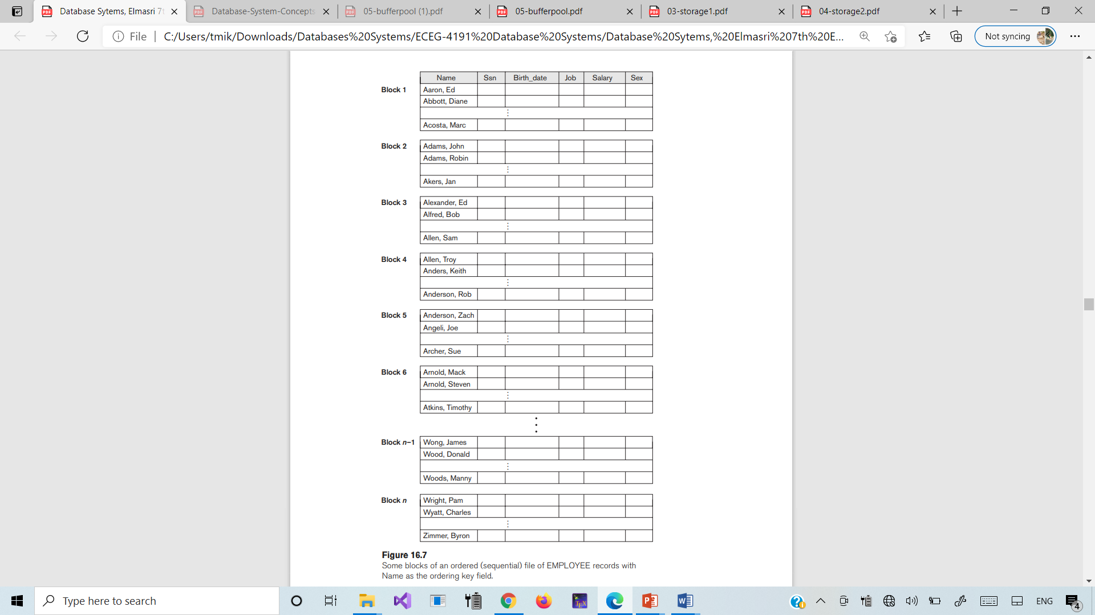
Some blocks of an ordered (sequential) file of EMPLOYEE records with Name as the ordering key field
Notes:
Some blocks of an ordered (sequential) file of EMPLOYEE records with Name as the ordering key field

Slide 37
Binary Search
A binary search for disk files can be done on the blocks rather than on the records.
Algorithm 16.1. Binary Search on an Ordering Key of a Disk File
l ← 1; u ← b; (*b is the number of file blocks*)
while (u ≥ l ) do
begin i ← (l + u) div 2;
read block i of the file into the buffer;
if K < (ordering key field value of the first record in block i ) then
u ← i − 1
else if K > (ordering key field value of the last record in block i ) then
l← i + 1
else if the record with ordering key field value = K is in the buffer then
goto found
else
goto notfound;
end;
goto notfound;
Notes:
Suppose that the file has b blocks numbered 1, 2, …, b; the records are ordered by ascending value of their ordering key field; and we are searching for a record whose ordering key field value is K. Assuming that disk addresses of the file blocks are available in the file header, the binary search can be described by Algorithm 16.1. A binary search usually accesses log2(b) blocks, whether the record is found or not—an improvement over linear searches, where, on the average, (b/2) blocks are accessed when the record is found and b blocks are accessed when the record is not found.

Slide 38

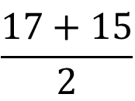
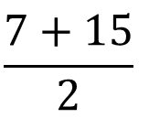
Example: Binary Search | Search for 83
0 | 1 | 2 | 3 | 4 | 5 | 6 | 7 | 8 | 9 | 10 | 11 | 12 | 13 | 14 | 15
1 | 15 | 19 | 20 | 21 | 22 | 22 | 25 | 26 | 26 | 33 | 54 | 76 | 83 | 88 | 98
L
mid = ceiling((l + u)/2)
= (0+15)/2
= 7.5
= 7
U
83 > 25
l = mid +1
l = 7 +1
= 8
0 | 1 | 2 | 3 | 4 | 5 | 6 | 7 | 8 | 9 | 10 | 11 | 12 | 13 | 14 | 15
1 | 15 | 19 | 20 | 21 | 22 | 22 | 25 | 26 | 26 | 33 | 54 | 76 | 83 | 88 | 98
L
$$\frac{7+15}{2}$$
U
0 | 1 | 2 | 3 | 4 | 5 | 6 | 7 | 8 | 9 | 10 | 11 | 12 | 13 | 14 | 15
1 | 15 | 19 | 20 | 21 | 22 | 22 | 25 | 26 | 26 | 33 | 54 | 76 | 83 | 88 | 98
L
U
$$\frac{17+15}{2}$$
Notes:
Suppose that the file has b blocks numbered 1, 2, …, b; the records are ordered by ascending value of their ordering key field; and we are searching for a record whose ordering key field value is K. Assuming that disk addresses of the file blocks are available in the file header, the binary search can be described by Algorithm 16.1. A binary search usually accesses log2(b) blocks, whether the record is found or not—an improvement over linear searches, where, on the average, (b/2) blocks are accessed when the record is found and b blocks are accessed when the record is not found.

Slide 39
Binary Search
Binary search. Given value and sorted array a[], find index i such that a[i] = value, or report that no such index exists.
Invariant. Algorithm maintains a[lo] ≤ value ≤ a[hi].
Ex. Binary search for 33.
6
13
14
25
33
43
51
53
64
72
84
93
95
96
97
0
1
2
3
4
5
6
7
8
9
10
11
12
13
14
lo
hi

Slide 40
Binary Search
Binary search. Given value and sorted array a[], find index i such that a[i] = value, or report that no such index exists.
Invariant. Algorithm maintains a[lo] ≤ value ≤ a[hi].
Ex. Binary search for 33.
6
13
14
25
33
43
51
53
64
72
84
93
95
96
97
0
1
2
3
4
5
6
7
8
9
10
11
12
13
14
lo
mid
hi

Slide 41
Binary Search
Binary search. Given value and sorted array a[], find index i such that a[i] = value, or report that no such index exists.
Invariant. Algorithm maintains a[lo] ≤ value ≤ a[hi].
Ex. Binary search for 33.
6
13
14
25
33
43
51
53
64
72
84
93
95
96
97
0
1
2
3
4
5
6
7
8
9
10
11
12
13
14
lo
hi

Slide 42
Binary Search
Binary search. Given value and sorted array a[], find index i such that a[i] = value, or report that no such index exists.
Invariant. Algorithm maintains a[lo] ≤ value ≤ a[hi].
Ex. Binary search for 33.
6
13
14
25
33
43
51
53
64
72
84
93
95
96
97
0
1
2
3
4
5
6
7
8
9
10
11
12
13
14
lo
mid
hi

Slide 43
Binary Search
Binary search. Given value and sorted array a[], find index i such that a[i] = value, or report that no such index exists.
Invariant. Algorithm maintains a[lo] ≤ value ≤ a[hi].
Ex. Binary search for 33.
6
13
14
25
33
43
51
53
64
72
84
93
95
96
97
0
1
2
3
4
5
6
7
8
9
10
11
12
13
14
lo
hi

Slide 44
Binary Search
Binary search. Given value and sorted array a[], find index i such that a[i] = value, or report that no such index exists.
Invariant. Algorithm maintains a[lo] ≤ value ≤ a[hi].
Ex. Binary search for 33.
6
13
14
25
33
43
51
53
64
72
84
93
95
96
97
0
1
2
3
4
5
6
7
8
9
10
11
12
13
14
lo
mid
hi

Slide 45
Binary Search
Binary search. Given value and sorted array a[], find index i such that a[i] = value, or report that no such index exists.
Invariant. Algorithm maintains a[lo] ≤ value ≤ a[hi].
Ex. Binary search for 33.
6
13
14
25
33
43
51
53
64
72
84
93
95
96
97
0
1
2
3
4
5
6
7
8
9
10
11
12
13
14
lo hi

Slide 46
Binary Search
Binary search. Given value and sorted array a[], find index i such that a[i] = value, or report that no such index exists.
Invariant. Algorithm maintains a[lo] ≤ value ≤ a[hi].
Ex. Binary search for 33.
6
13
14
25
33
43
51
53
64
72
84
93
95
96
97
0
1
2
3
4
5
6
7
8
9
10
11
12
13
14
lo hi mid

Slide 47
Binary Search
Binary search. Given value and sorted array a[], find index i such that a[i] = value, or report that no such index exists.
Invariant. Algorithm maintains a[lo] ≤ value ≤ a[hi].
Ex. Binary search for 33.
6
13
14
25
33
43
51
53
64
72
84
93
95
96
97
0
1
2
3
4
5
6
7
8
9
10
11
12
13
14
lo hi mid

Slide 48
Files of Unordered Records (Heap Files)
Heap (or pile) file
Simplest file structure contains records in no particular order.
Records placed in file in order of insertion
Inserting a new record is very efficient
Searching for a record requires linear search
Deletion techniques
Rewrite the block
Use deletion marker
Require periodic reorganization of the file
Notes:
first find its block, copy the block into a buffer, delete the record from the buffer, and finally rewrite the block back to the disk. This leaves unused space in the disk block. Deleting a large number of records in this way results in wasted storage space.
to have an extra byte or bit, called a deletion marker, stored with each record. A record is deleted by setting the deletion marker to a certain value.

Slide 49
Unordered (Heap) Files
As file grows and shrinks, disk pages are allocated and de-allocated.
To support record level operations, we must:
keep track of the pages in a file
keep track of free space on pages
keep track of the records on a page
There are many alternatives for keeping track of this.
Linked List
Page Directory

Slide 50
Heap File: Linked List
Maintain a header page at the beginning of the file that stores two pointers:
Free Page
List
Page 1
Page 4
…
HEAD of the free page list.
HEAD of the data page list.
Data
Data
Header
Page 0
Page 2
…
Data Page
List
Data
Data
Each page keeps track of how many free slots they currently have.

Slide 51
Heap File: Page Directory
The DBMS maintains special pages that tracks the location of data pages in the database files.
Page 0
The directory also records the number of free slots per page.
The DBMS must make sure that the directory pages are in sync with the data pages.
Data
Directory
Page 1
Data
…
Page N
Data

Slide 52
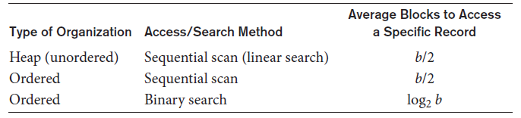
Access Times for Various File Organizations
Average access times for a file of b blocks under basic file organizations

Slide 53
Other Primary File Organizations
B-tree data structure
Column-based data storage
Files of mixed records
Relationships implemented by logical field references
Physical clustering

Slide 54
B+ TREE
A B+Tree is a self-balancing tree data structure that keeps data sorted and allows searches, sequential access, insertions, and deletions in O(log n).
→ Generalization of a binary search tree in that a node can have more than two children.
→ Optimized for systems that read and write large blocks of data.

Slide 55
NODES
Every B+Tree node is comprised of an array of key/value pairs.
→ The keys are derived from the attributes(s) that the index
is based on.
→ The values will differ based on whether the node is classified as inner nodes or leaf nodes.
The arrays are (usually) kept in sorted key order.

Slide 56
Structure of Internal Nodes of B⁺-Trees
A₁ K₁ ..........
A_{k}
^{K}i-1
A_{i} K_{i}
..........^{K}k-1
tree
tree
pointer
tree
pointer
pointer
X
X
X
X ≤ K₁
K_{i-1} < X ≤ K_{i}
K_{k-1} < X
Internal node of a B⁺ - tree

Slide 57
Structure of Leaf nodes of B⁺-Trees
K₁
R₁
K₂
R₂
..........
K_{i}
R_{i}
..........
^{K}k-1
^{R}k-1
^{R}next
data pointer
data pointer
data pointer
data pointer
Leaf node of a B⁺ - tree

Slide 58
B+ TREE EXAM PLE
Inner Node
<node*>|<key>
5
9
<5
<9
≥9
1
3
6
7
9
13
Leaf Nodes
Sibling Pointers
<value>|<key>

Slide 59
B+ TREE EXAM PLE
Inner Node
<node*>|<key>
5
9
<5
<9
≥9
1
3
6
7
9
13
Leaf Nodes
Sibling Pointers
<value>|<key>

Slide 60
Example of B⁺-Tree

Slide 61
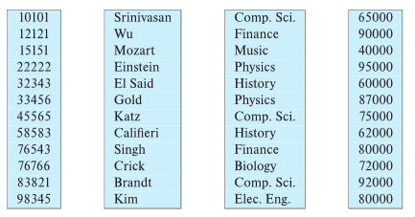
Column-Oriented Storage
Also known as columnar representation
Store each attribute of a relation separately
Example

Slide 62
Columnar Representation
Benefits:
Reduced IO if only some attributes are accessed
Improved CPU cache performance
Improved compression
Vector processing on modern CPU architectures
Drawbacks
Cost of tuple reconstruction from columnar representation
Cost of tuple deletion and update
Cost of decompression
Columnar representation found to be more efficient for decision support than row-oriented representation
Traditional row-oriented representation preferable for transaction processing
Some databases support both representations
Called hybrid row/column stores

Slide 63
Columnar Representation
Database implementations that are designed purely for data warehouse applications include
Teradata,
Sybase IQ, and
Amazon Redshift.
Many traditional databases support efficient execution of data warehousing applications by adding features such as columnar storage; these include
Oracle,
SAP HANA,
Microsoft SQL Server, and
IBM DB2.

Slide 64
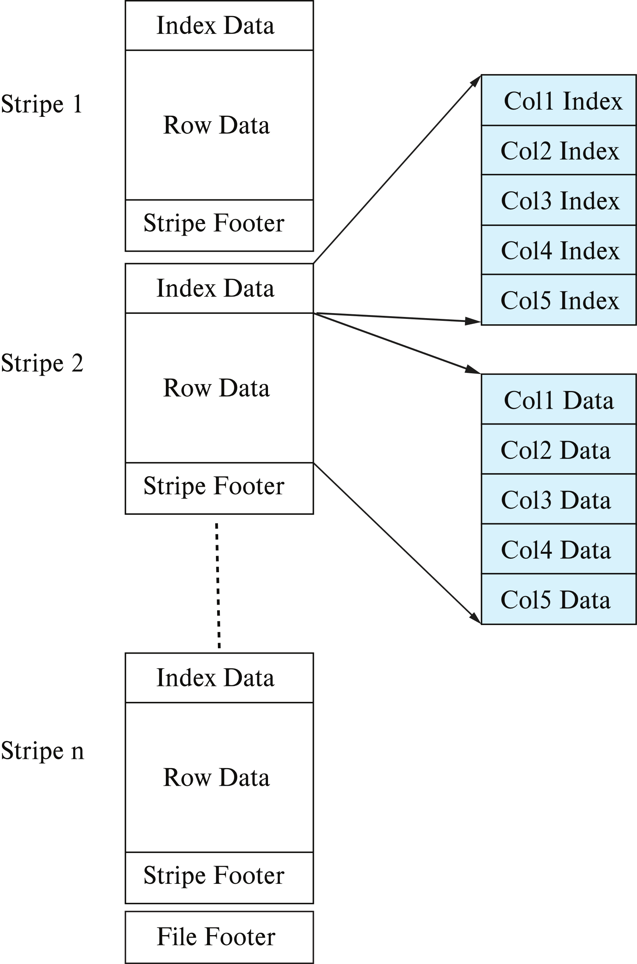
Columnar File Representation
Compressed file structures containing records with columns, such as Orc and Parquet, are increasingly used to store such log records, simplifying integration with SQL.
ORC and Parquet:
file formats with columnar storage inside file
Very popular for big-data applications
ORC file format shown on right:
Notes:
Since the 2010s there has been an explosive growth in Big Data systems that are designed to process queries over data stored in files. Such systems are now a key part of the data warehouse infrastructure.

Slide 65
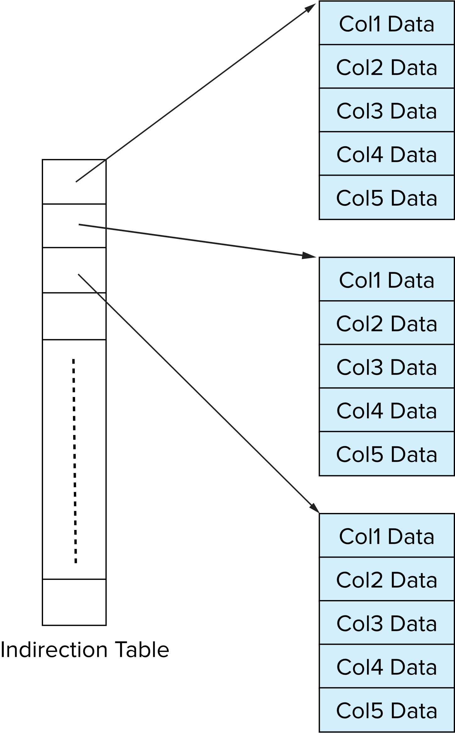
Storage Organization in Main-Memory Databases
Can store records directly in memory without a buffer manager
Column-oriented storage can be used in-memory for decision support applications
Compression reduces memory requirement

Slide 66
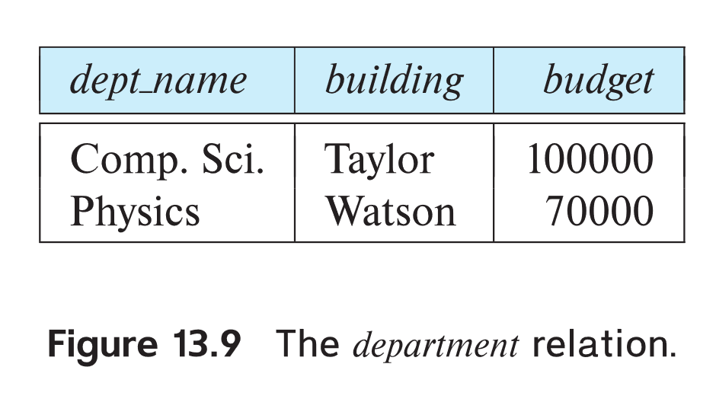
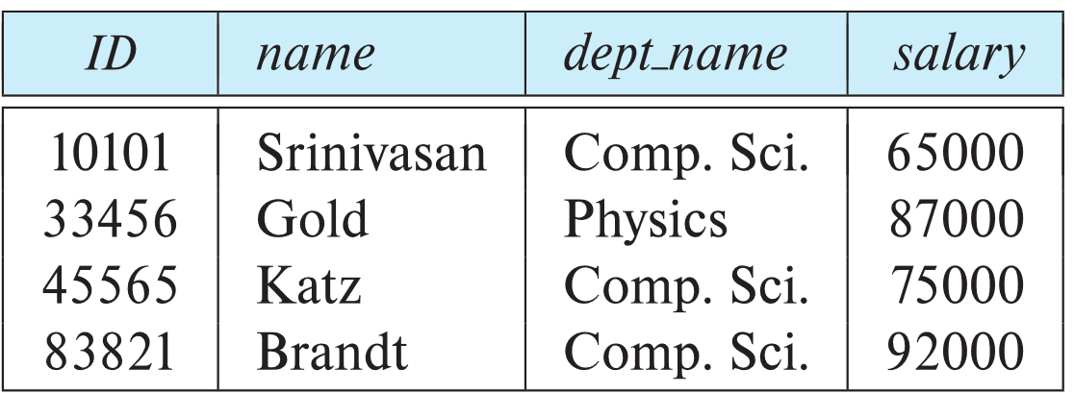
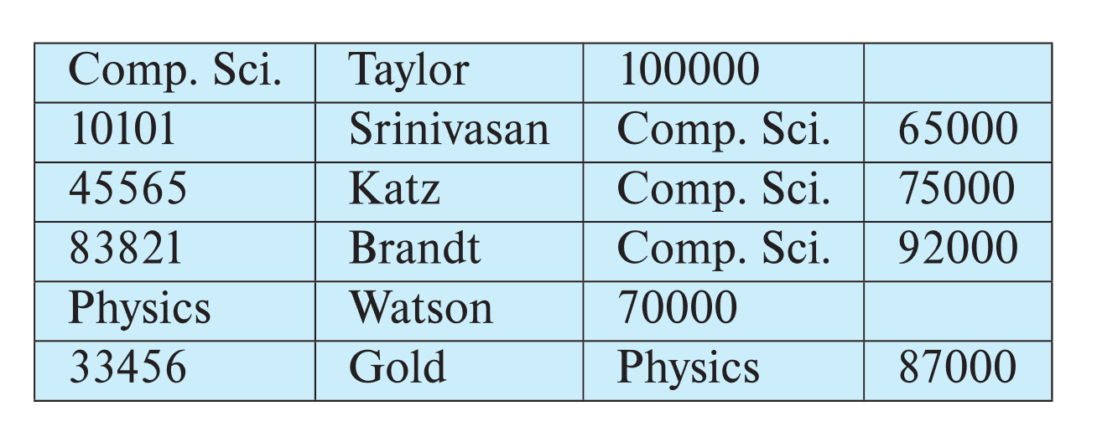
Multitable Clustering File Organization
Store several relations in one file using a multitable clustering file organization
department
instructor
multitable clustering
of department and
instructor

Slide 67
Multitable Clustering File Organization (cont.)
good for queries involving department ⨝ instructor, and for queries involving one single department and its instructors
bad for queries involving only department
results in variable size records
Can add pointer chains to link records of a particular relation

Slide 68
Partitioning
Table partitioning: Records in a relation can be partitioned into smaller relations that are stored separately
E.g., transaction relation may be partitioned into transaction_2018, transaction_2019, etc.
Queries written on transaction must access records in all partitions
Unless query has a selection such as year=2019, in which case only one partition in needed
Partitioning
Reduces costs of some operations such as free space management
Allows different partitions to be stored on different storage devices
E.g., transaction partition for current year on SSD, for older years on magnetic disk

Slide 69
Data Dictionary Storage
The Data dictionary (also called system catalog) stores metadata; that is, data about data, such as
Information about relations
names of relations
names, types and lengths of attributes of each relation
names and definitions of views
integrity constraints
User and accounting information, including passwords
Statistical and descriptive data
number of tuples in each relation
Physical file organization information
How relation is stored (sequential/hash/…)
Physical location of relation

Slide 70
Relational Representation of System Metadata
Relational representation on disk
Specialized data structures designed for efficient access, in memory

Slide 71
Review
Disk Storage Structures

Slide 72
Heap File: Page Directory
Page 0
Data
Directory
Page 1
Data
…
Page N
Data

Slide 73
Page Header
Every page contains a header of metadata about the page's contents.
→ Page Size
→ Checksum
→ DBMS Version
→ Transaction Visibility
→ Compression Information
Page
Header
Data

Slide 74
Tuple Storage
How to store tuples in a page?
Page
Strawman Idea:
Keep track of the number of tuples in a page and then just append a new tuple to the end.
Num Tuples = 0

Slide 75
Tuple Storage
How to store tuples in a page?
Page
Strawman Idea:
Keep track of the number of tuples in a page and then just append a new tuple to the end.
Num Tuples = 3
Tuple #1
Tuple #2
Tuple #3
Num Tuples = 0

Slide 76
Tuple Storage
How to store tuples in a page?
Page
Strawman Idea:
Keep track of the number of tuples in a page and then just append a new tuple to the end.
→ What happens if we delete a tuple?
Num Tuples = 2
Tuple #1
Tuple #3
Num Tuples = 0
Num Tuples = 3

Slide 77
Tuple Storage
How to store tuples in a page?
Page
Strawman Idea:
Keep track of the number of tuples in a page and then just append a new tuple to the end.
→ What happens if we delete a tuple?
Num Tuples = 3
Tuple #1
Tuple #4
Tuple #3
Num Tuples = 0

Slide 78
Tuple Storage
How to store tuples in a page?
Page
Strawman Idea:
Keep track of the number of tuples in a page and then just append a new tuple to the end.
Num Tuples = 3
Tuple #1
Tuple #4
Tuple #3
Num Tuples = 0
→ What happens if we delete a tuple?
→ What happens if we have a variable length attribute?

Slide 79
Slotted Pages
The most common layout scheme is called slotted pages.
Slot Array
The slot array maps "slots" to the tuples' starting position offsets.
Header
The header keeps track of:
→ The # of used slots
→ The offset of the starting location of the last slot used.
Tuple #4
Tuple #3
Tuple #2
Tuple #1
Fixed and variable length Tuple Data

Slide 80
Slotted Pages
The most common layout scheme is called slotted pages.
The slot array maps "slots" to the tuples' starting position offsets.
Header
The header keeps track of:
→ The # of used slots
→ The offset of the starting location of the last slot used.
Tuple #4
Tuple #3
Tuple #2
Tuple #1

Slide 81
Slotted Pages
The most common layout scheme is called slotted pages.
Slot Array
The slot array maps "slots" to the tuples' starting position offsets.
Header
The header keeps track of:
→ The # of used slots
→ The offset of the starting location of the last slot used.
Tuple #4
Tuple #3
Tuple #2
Tuple #1
Fixed- and Var- length Tuple Data

Slide 82
Slotted Pages
The most common layout scheme is called slotted pages.
Slot Array
The slot array maps "slots" to the tuples' starting position offsets.
Header
The header keeps track of:
→ The # of used slots
→ The offset of the starting location of the last slot used.
Tuple #4
Tuple #2
Tuple #1
Fixed- and Var- length Tuple Data

Slide 83
Slotted Pages
The most common layout scheme is called slotted pages.
Slot Array
The slot array maps "slots" to the tuples' starting position offsets.
Header
The header keeps track of:
→ The # of used slots
→ The offset of the starting location of the last slot used.
Tuple #4
Tuple #2
Tuple #1
Fixed- and Var- length Tuple Data

Slide 84




RECO RD IDS
The DBMS needs a way to keep track of individual tuples.
Each tuple is assigned a unique record identifier.
→ Most common: page_id + offset/slot
→ Can also contain file location info.
An application cannot rely on these ids to mean anything.
CTID (6- bytes)
ROWID (8- bytes)
ROWID (10- bytes)

Slide 85
Tuple Layout
A tuple is essentially a sequence of bytes.
It's the job of the DBMS to interpret those bytes into attribute types and values.

Slide 86
Tuple Header
Tuple
Header
Attribute Data
Each tuple is prefixed with a header that contains meta-data about it.
→ Visibility info (concurrency control)
→ Bit Map for NULL values.
We do not need to store meta-data about the schema.

Slide 87
Tuple Data
Tuple
Attributes are typically stored in the order that you specify them when you create the table.
Header | a | b | c | d | e
CREATE TABLE foo
(
a INT PRIMARY KEY,
b INT NOT NULL,
c INT,
d DOUBLE,
e FLOAT
);
Notes:
This is done for software engineering reasons.

Slide 88
Denormalized Tuple Data
CREATE TABLE foo (
a INT PRIMARY KEY,
b INT NOT NULL
);
CREATE TABLE bar (
c INT PRIMARY KEY,
a INT
⮱REFERENCES foo (a)
);
Can physically denormalize (e.g., "pre join") related tuples and store them together in the same page.
→ Potentially reduces the amount of I/O for common workload patterns.
→ Can make updates more expensive.

Slide 89
Denormalized Tuple Data
Can physically denormalize (e.g., "pre join") related tuples and store them together in the same page.
foo
Header | a | b
→ Potentially reduces the amount of I/O for
common workload patterns.
→ Can make updates more expensive.
bar
Header | c | a
Header | c | a
Header | c | a

Slide 90






Denormalized Tuple Data
Can physically denormalize (e.g., "pre join") related tuples and store them together in the same page.
→ Potentially reduces the amount of I/O for
common workload patterns.
→ Can make updates more expensive.
Not a new idea.
→ IBM System R did this in the 1970s.
→ Several NoSQL DBMSs do this without
calling it physical denormalization.
foo
Header
a
b
c | c | c | …
foo
bar

